Slide 1


FOR COMPANY STAKEHOLDERS
Why We Need to Be Involved in Standards Development

Slide 2
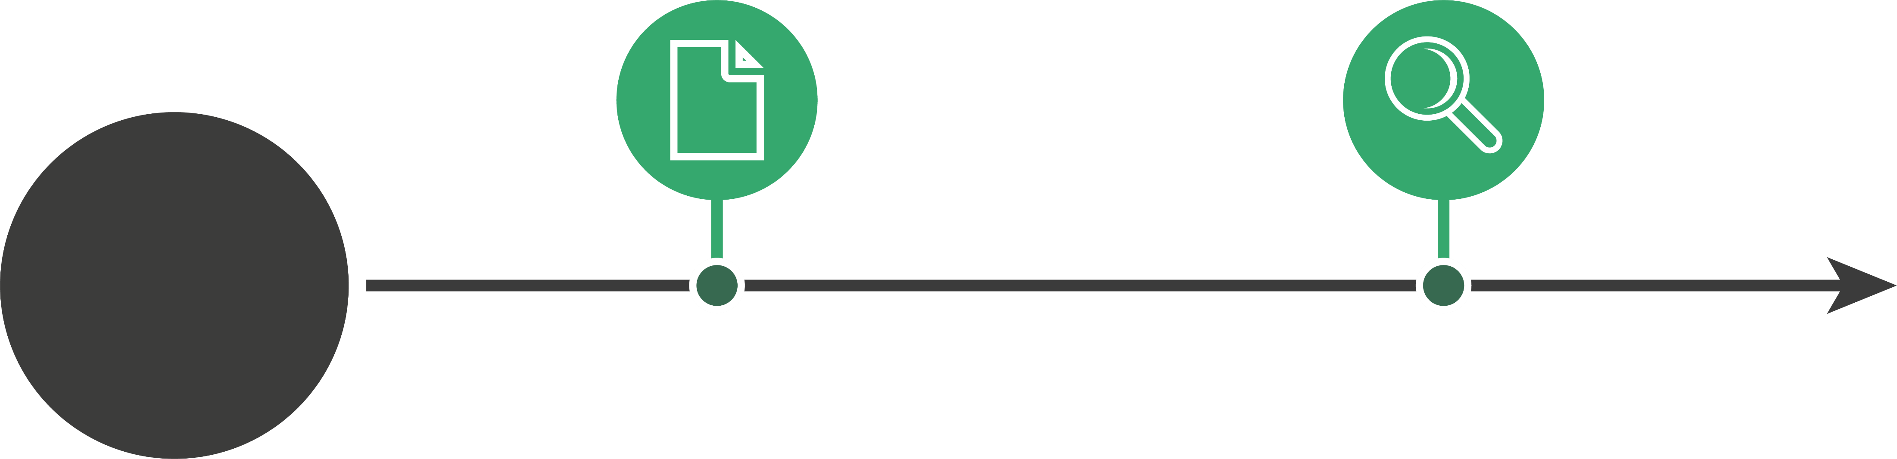
Standardization, in a Nutshell
STANDARDIZATION =
Standards + Conformity Assessment
Product, service, management system, etc.
INCREASED TRUST AND VALUE
STANDARDS
Voluntary guidelines on how to design, manage, or create materials, products, processes, and services
Created by experts from industry, government, consumers, academia, and others—all working together
CONFORMITY ASSESSMENT
Verification that the standard was actually met
Instills confidence in the widespread use of products, personnel, services, and systems

Slide 3
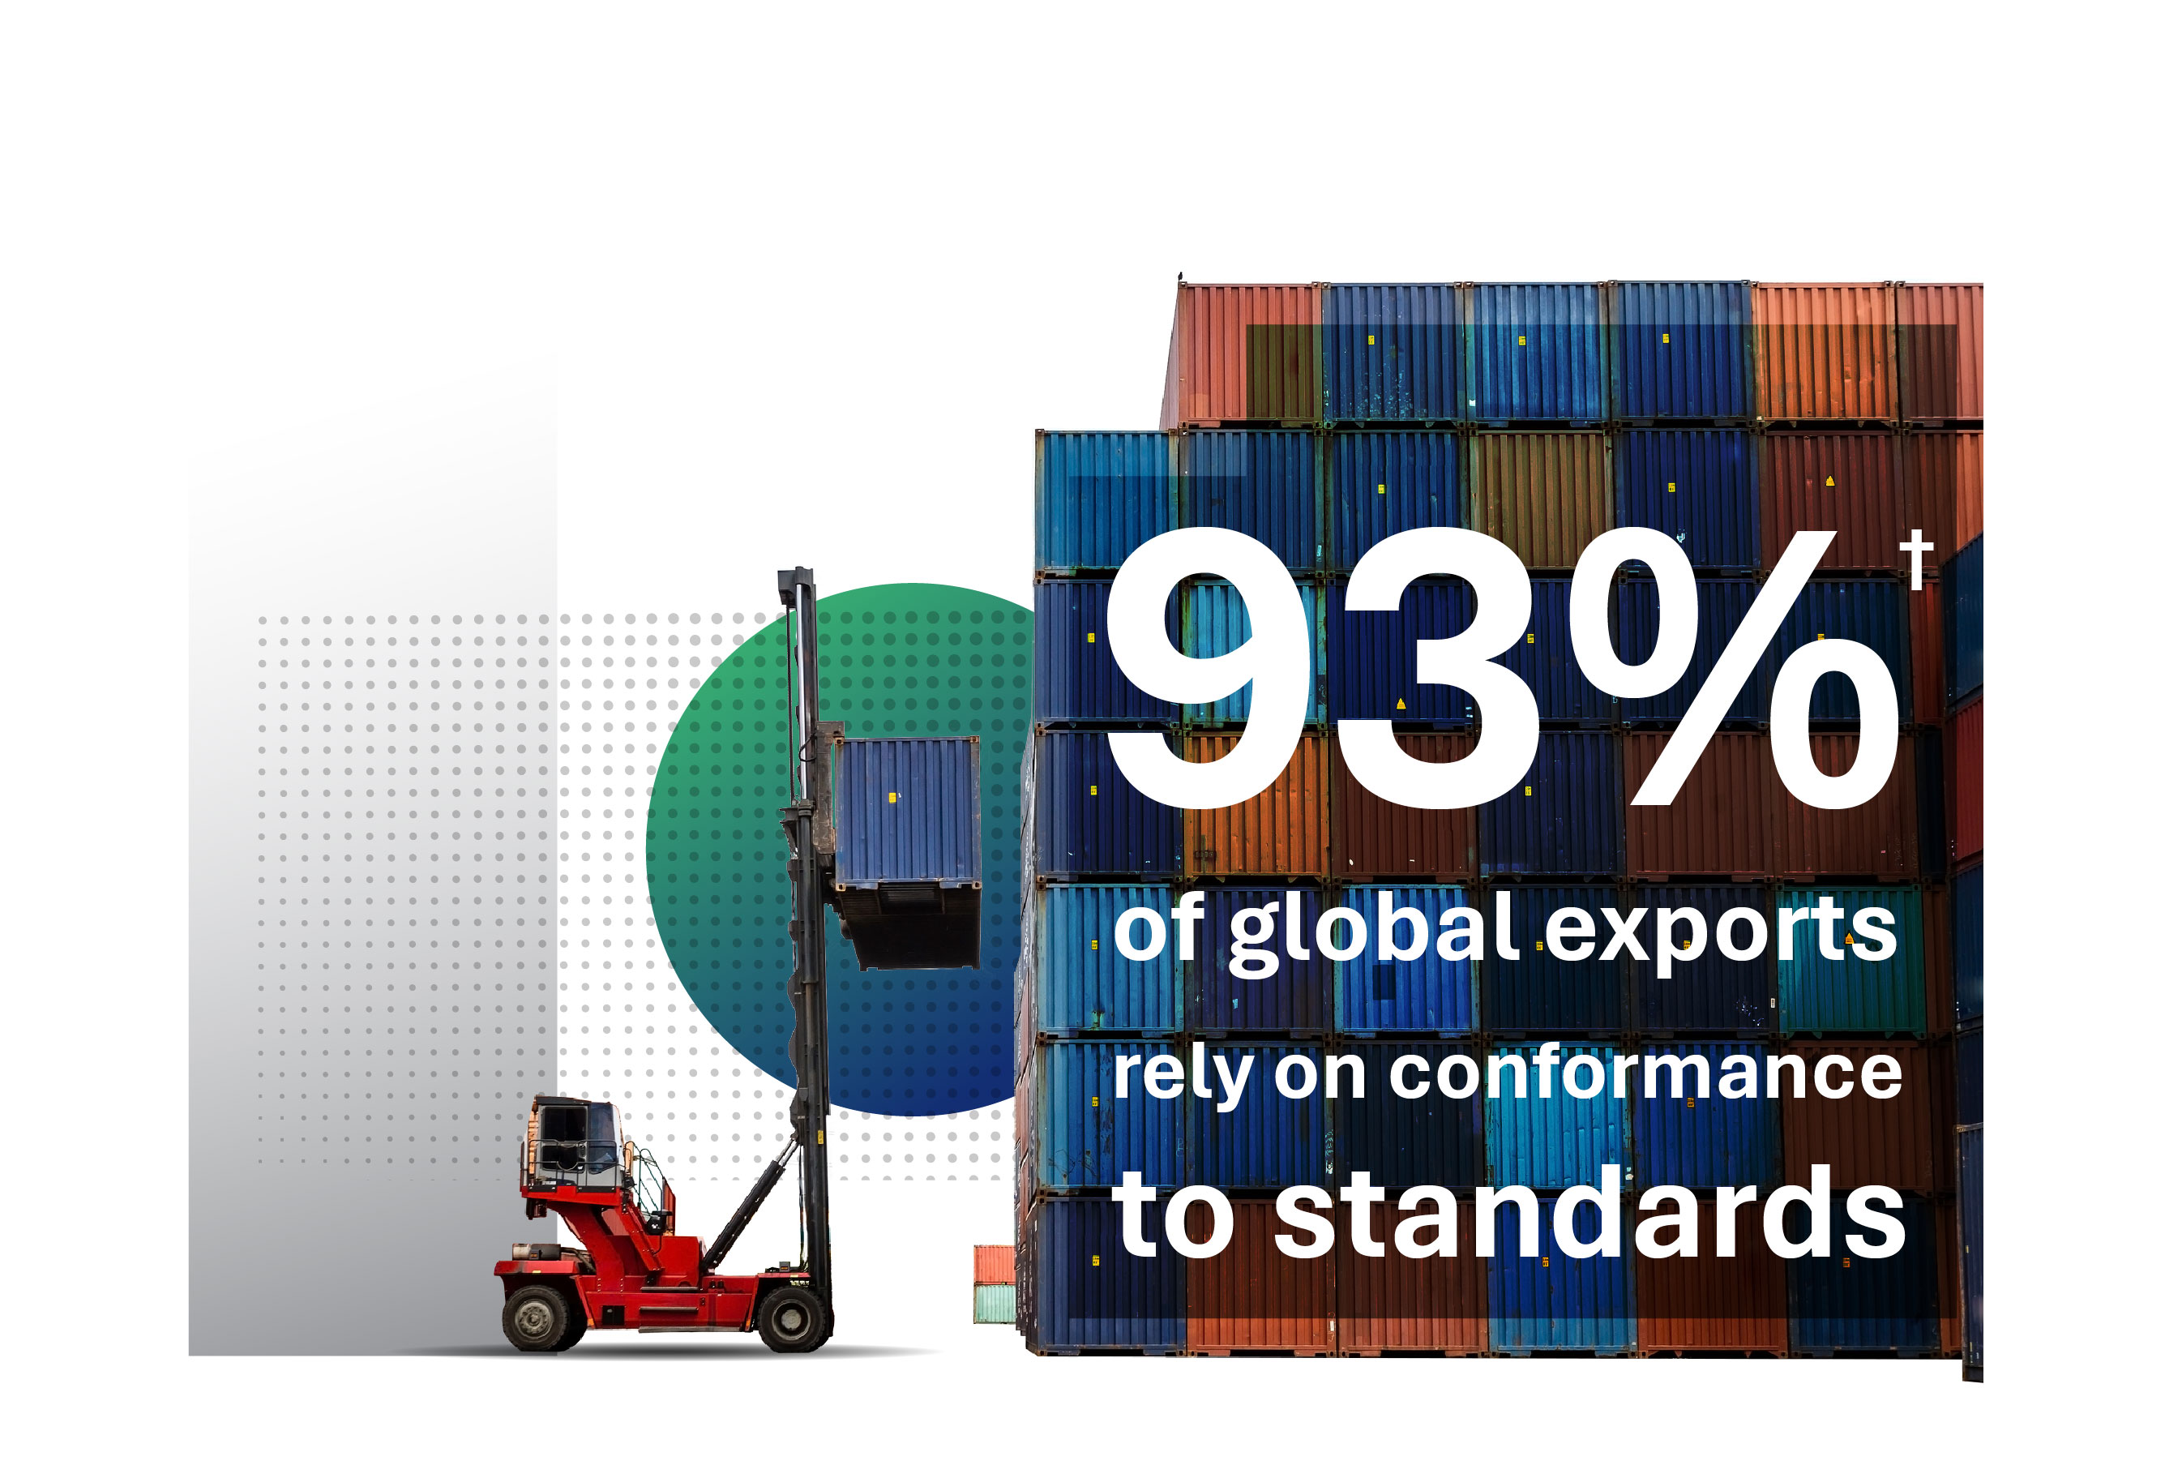
Why is Standardization Important?
All aspects of our products and services are affected at some point by standardization, which includes standards and conformance to standards.
We can’t afford to not be involved.
†Source: U.S. Department of Commerce, International Trade Administration

Slide 4
How Standards Boost Business

Slide 5
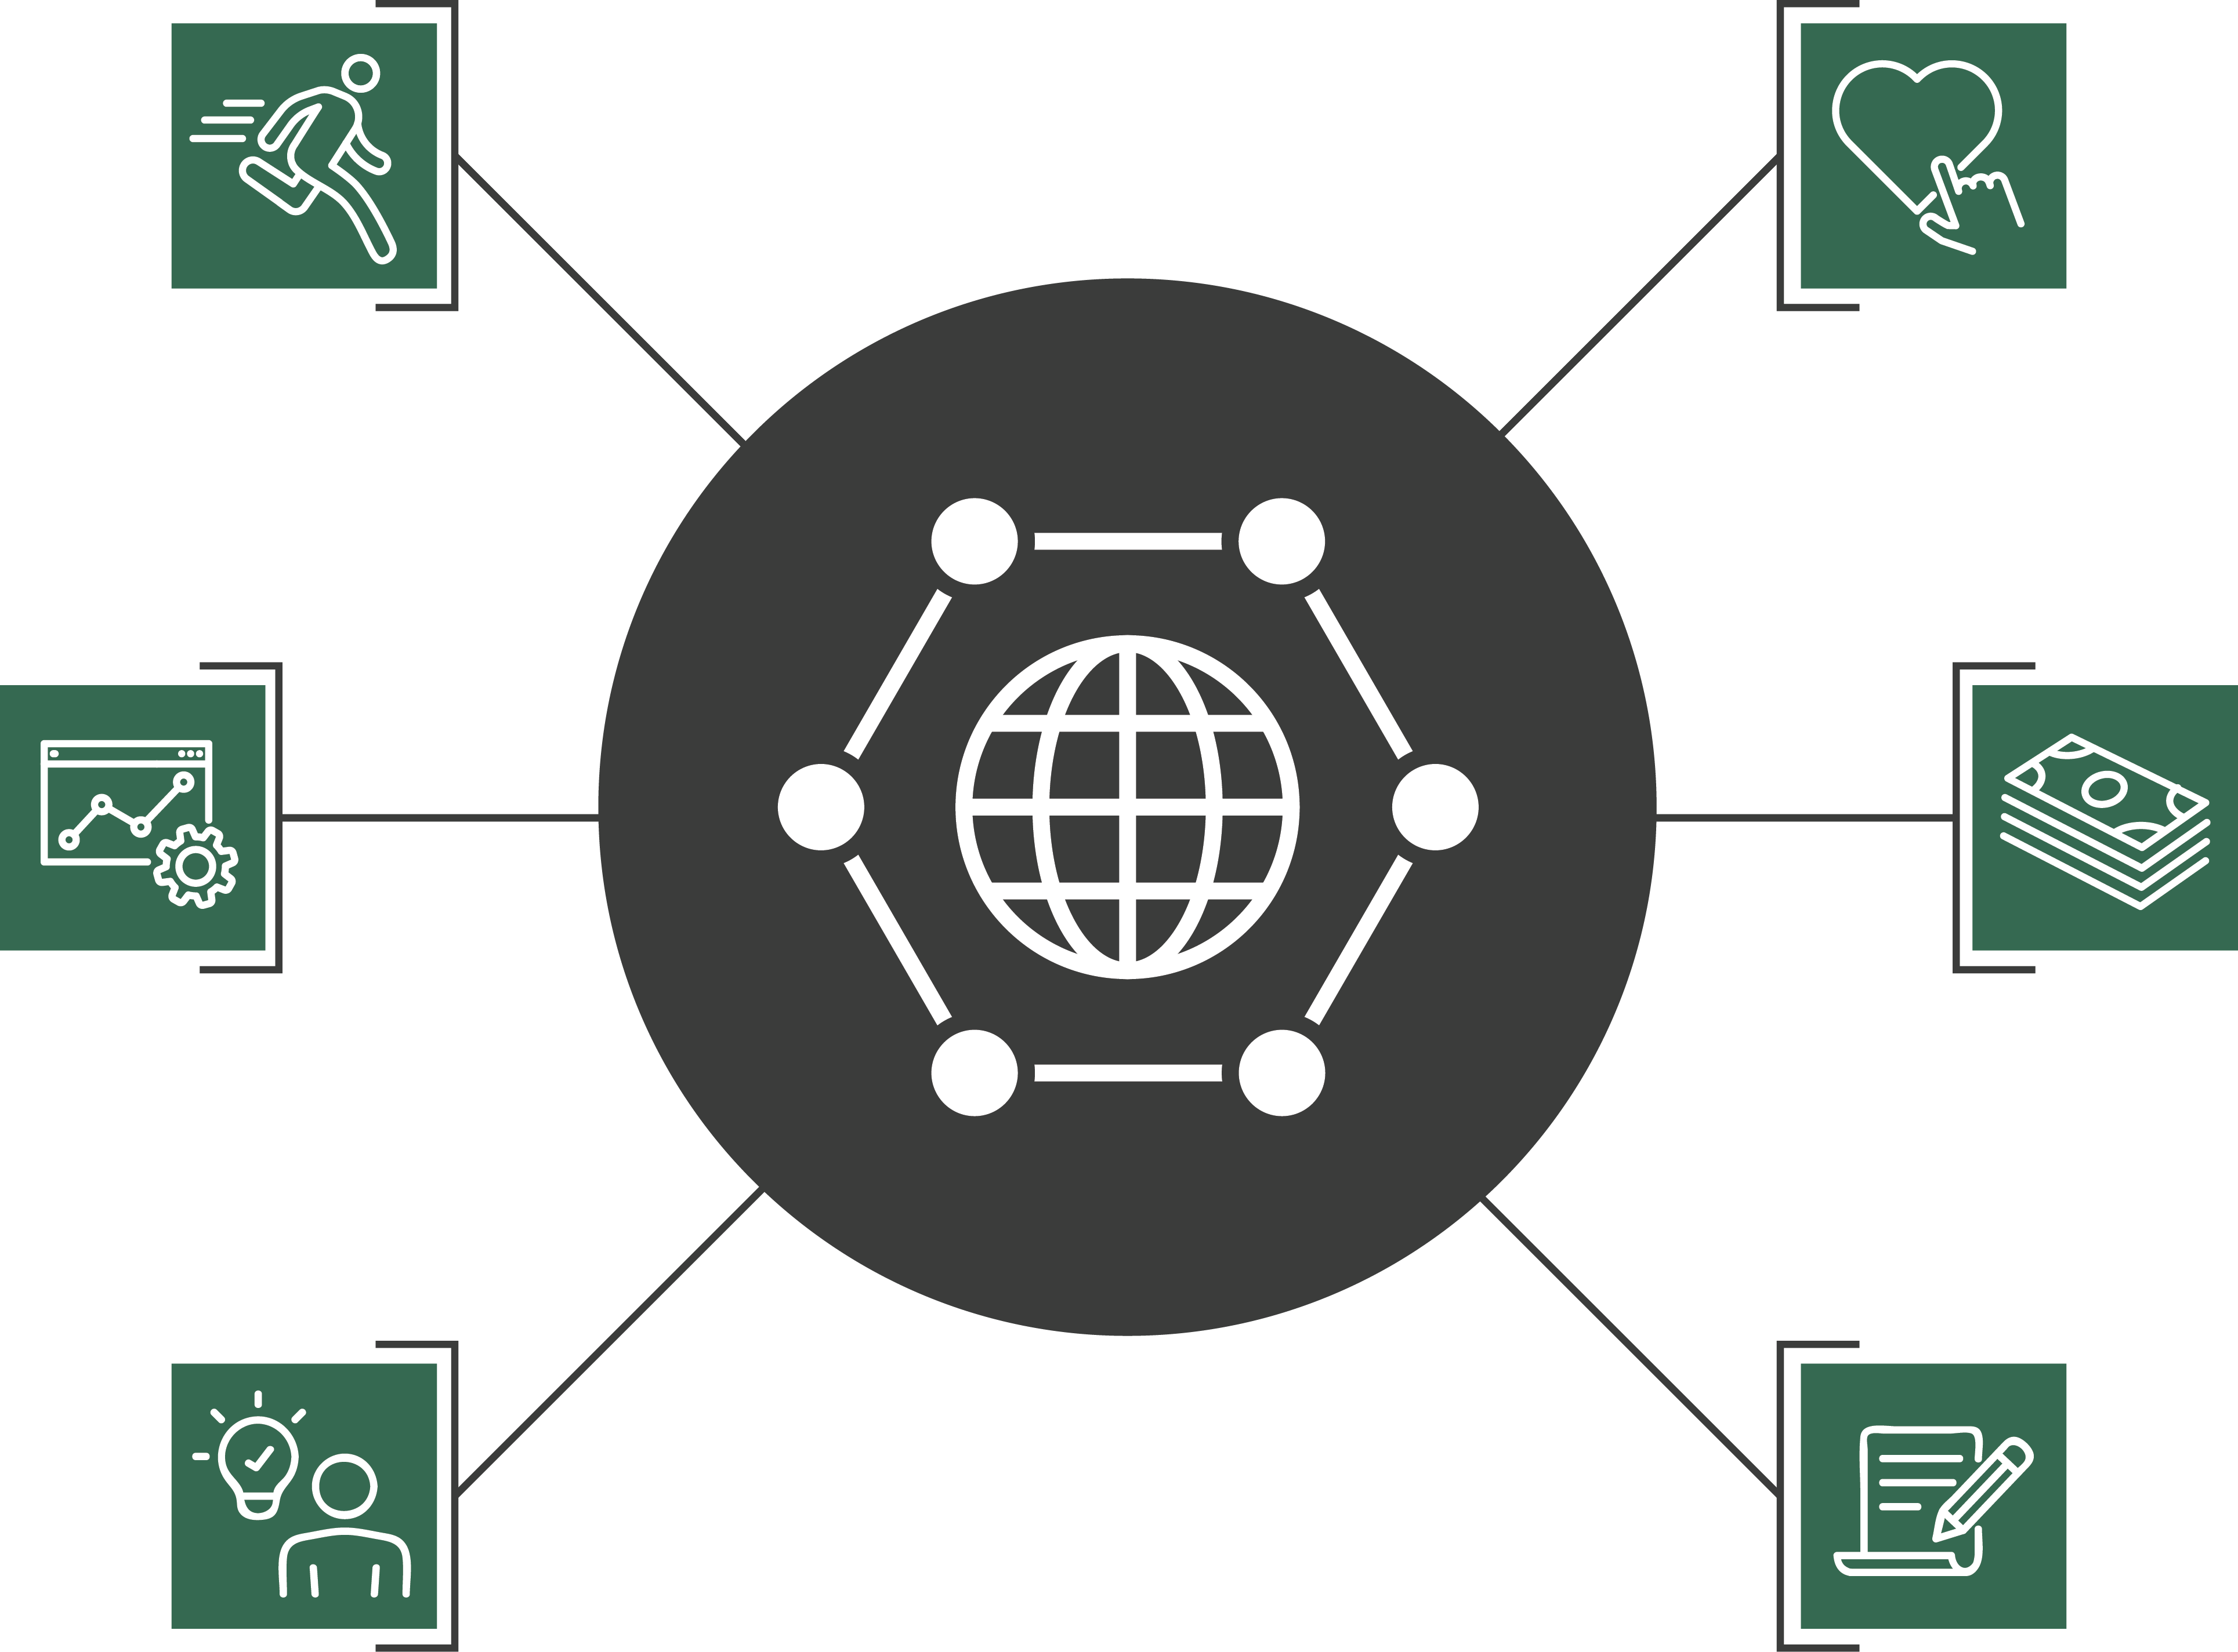
How Can Standards Boost Business?
Consumer confidence, trust, and loyalty
Competitiveness
Market access and trade
Efficiency and cost savings
Inform, complement, or serve in lieu of regulation
Innovation
and R&D

Slide 6




Competitiveness
Companies participating in standards development….
Gain critical knowledge, information, and professional skills
Proactively shape standards’ technical content
Collaborate with public and private stakeholders whose input impacts our business
Position products, services, and technologies for access to new and existing markets
Why Should We Be Involved?
On almost any given day, a standards group or technical committee is making decisions that could affect our bottom line—and our business.

Slide 7











Efficiency and Cost Savings
Standardization saves time and money by:
+
IMPROVING
–
REDUCING
Safety
Duplication of efforts
Operational efficiency
Errors
ROI
Time to market
Reliability
Cost
Quality
Risk
Supply-chain management

Slide 8
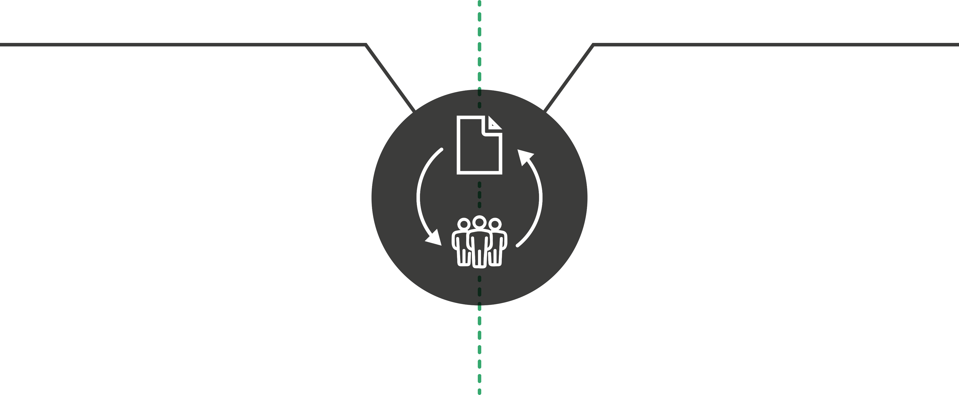
Innovation and R&D
INCORPORATING EXISTING STANDARDS INTO OUR BUSINESS
GETTING INVOLVED IN THE STANDARDIZATION PROCESS
Reduces time for introducing new products to market by building on previously standardized technologies and methodologies
Lowers some R&D costs
Shortens the cycle of product development
Builds on the foundation for innovation that standards provide
Gains knowledge to inform new products, services, and technologies
Directly influences the requirements and guidelines for our products

Slide 9
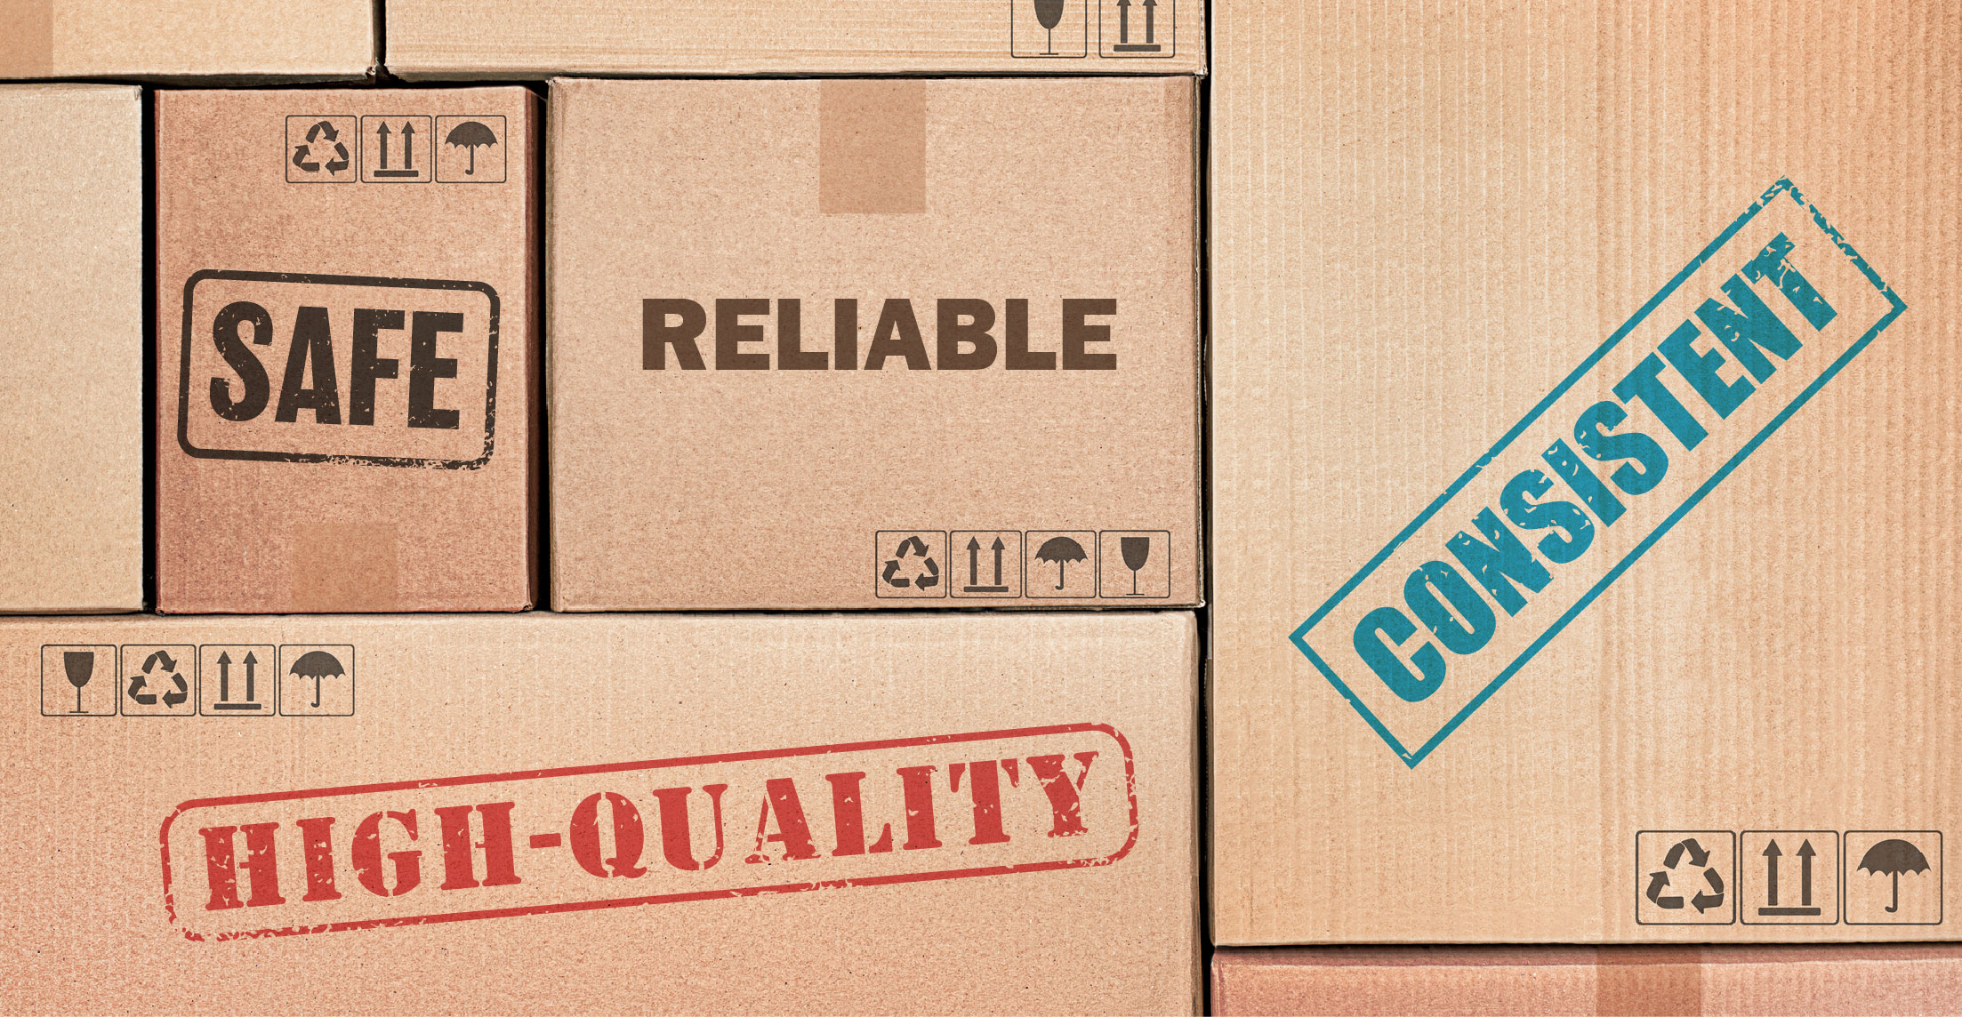
Consumer Confidence, Trust, and Loyalty
Consumers want products that are…
…with a greater selection and at lower cost.
Standardization helps make
this possible!
Standardization benefits public health, safety, and the environment, and gives customers confidence in the products they purchase.
Products that take these needs into account are more likely to be accepted into the marketplace.

Slide 10
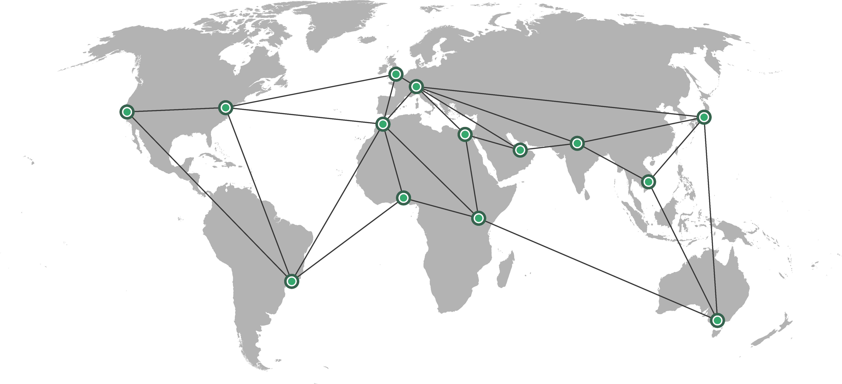
Market Access and Trade
Standardization is inextricably linked to all levels of our supply chain.
Standardization enables interoperability, the backbone of globalized trade.
Standardization fosters innovation and shortens the cycle from concept to global market access.
Standardization breaks down technical barriers to trade when following WTO principles.

Slide 11

Inform, complement, or serve in lieu of regulation
Standards can be an alternative to top-down government regulation,
or inform/supplement regulation.
The U.S. standardization community is market driven and private-sector led with active participation from all affected stakeholders, including government.

Slide 12
How We Get There

Slide 13

Evaluate…
Areas of our business that are affected by or can be enhanced by standardization
Which standardization solutions already exist that are relevant to our business — are there any gaps?
The resources—time, money, and personnel—we are able to commit to participating in the U.S. and global standardization systems
How to maximize ROI from standards engagement
The cost to our business if we don’t participate

Slide 14

Educate…
Employees about how standards support business goals and day-to-day work
Employees about opportunities to participate in the standardization process
Early- and mid-career employees about professional development and mentoring opportunities in standardization.
Key decision makers on the strategic importance of standards

Slide 15

Act…
To support employees’ participation in standardization efforts
To ensure that our company policies support standards development along with quality, safety, and environmental performance
To commit resources to our standardization efforts

Slide 16
[Supplement this deck]
Feel free to add a slide citing specific examples of how standards boost business relevant to your company.
Don’t have one? Add a case study from the appendix!

Slide 17
For More Information
<Employee name>
<Employee title>
<email>@ansi.org
www.ansi.org
webstore.ansi.org

Slide 18
Appendix

Slide 19



Case Study: Bentley Motors
Challenge: Modernizing their procedures in the historic building that has housed their entire operation since 1938.
Solution: Implemented ISO 50001, Energy Management Systems and ISO 14001, Environmental Management Systems
Impact: Reduced energy use by 66% for each car produced, and 14% for the entire plant. Saved enough energy to power 11,500 houses for a year.
Source: Bentley and ISO

Slide 20
Case Study: ICAO E-passports
Challenge: Improving electronic machine-readable travel documents that link passports to their rightful owner to improve border control and identity management
Solution: The UN’s International Civil Aviation Organization (ICAO) used ISO/IEC 19794, Information Technology – Biometric data interchange formats and ISO/IEC 19785, Information Technology – Common biometric exchange formats framework (CBEFF), for a logical data structure for biometric information records in their guidance Document 9303.
Impact: The adoption of standards was highly successful in the use of biometrics for ePassports, allowing some 150 nations to issue interoperable travel documents. To date, there are roughly one billion ePassports in circulation, resulting in a far smoother experience for travelers, while not sacrificing border security.
Source: ICAO Adopts JTC 1/SC 37 Standards to Support Biometric Technology for Machine Readable Travel Documents; 20-year Anniversary Report: ICAO; Mind the Gap: Supporting Global ICAO Digital Travel Credential Implementation

